Slide 1

NextGen Innovation
Research quality innovation

Slide 2
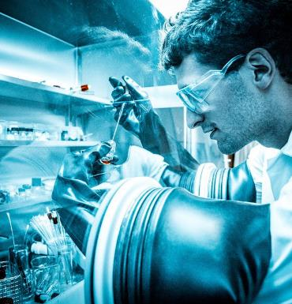


We believe that quality in research produces innovation

Slide 3
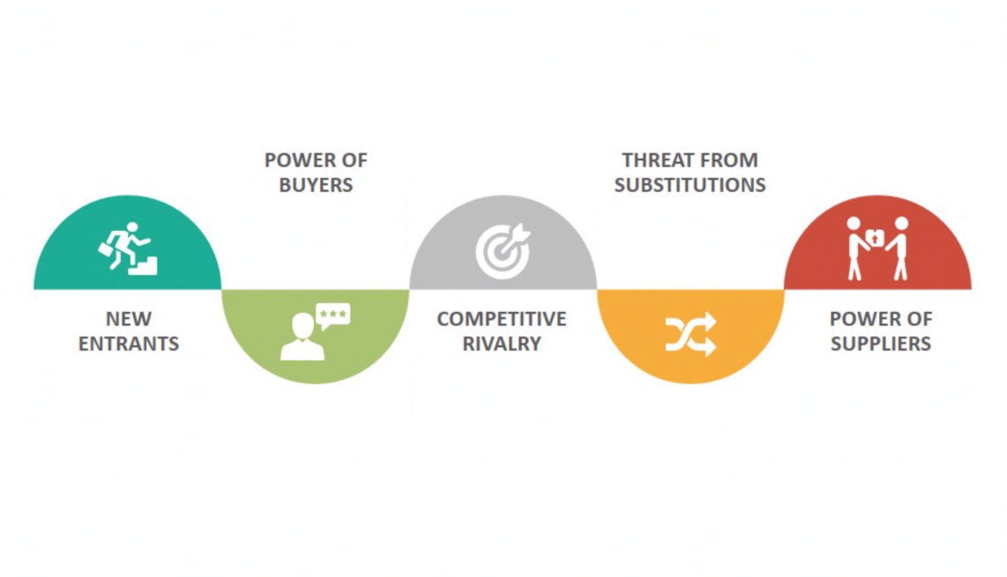






Slide 4
Competitors

Slide 5

Our strength?

Slide 6

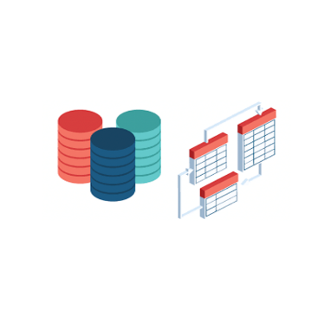

Data collection
Data processing
through disambiguation
algorithm

Slide 7
…what about privacy?

Slide 8
Sales
Company
consultancy
2500 - 5000 €
University pack
1780 €/y
Land pack
20 €/y

Slide 9



Marketing

Slide 10
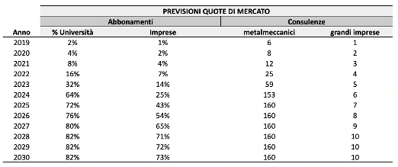
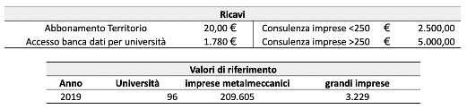
Ricavi

Slide 11
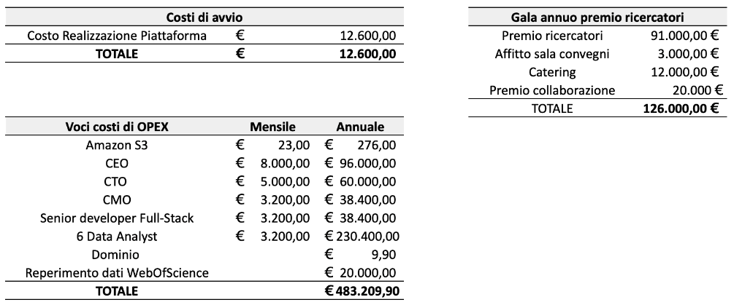
Costi

Slide 12
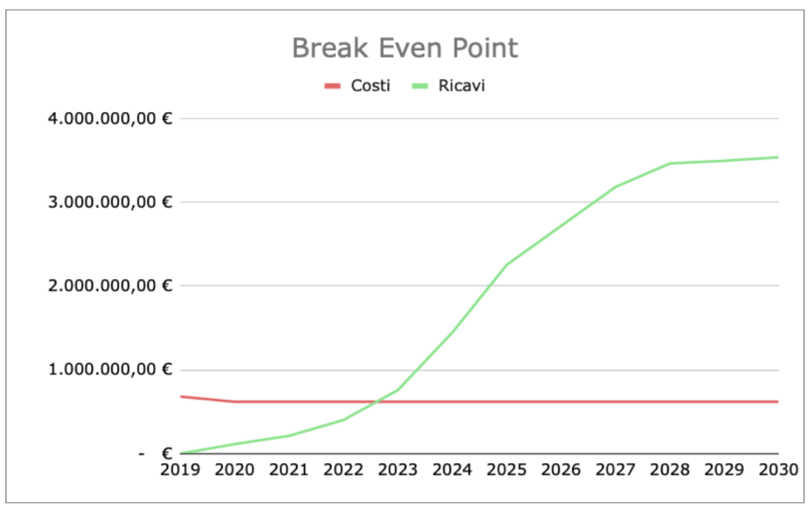

Slide 13
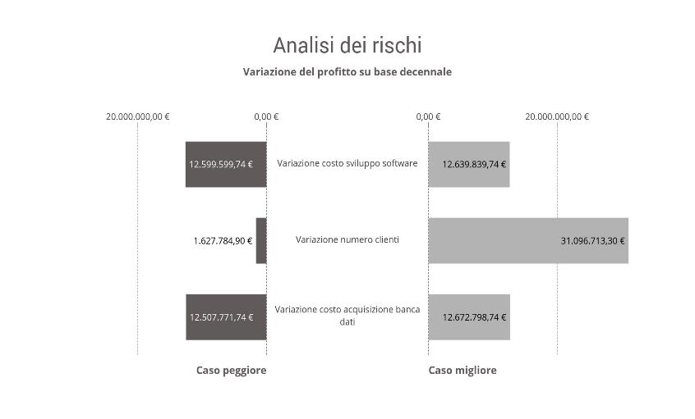
Risks

Slide 14
Project status and fundings
Algorithm tested with success
Software developement completed at 89%
Platform up and running within first quarter 2020
Needed fundings: €150.000

Slide 15
Thanks for your attention! Any question?

